Slide 1
Applied Physics NS (101)
LECTURE # 10
DATE: 27TH OCTOBER , 2020

Slide 2
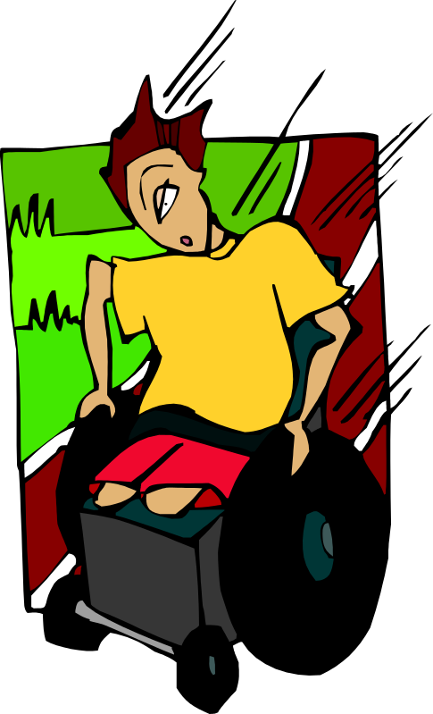
Forces and Motion
Forces can create changes in motion (acceleration or deceleration).

Slide 3


Definition of a Force
A force is a push or a pull.

Slide 4
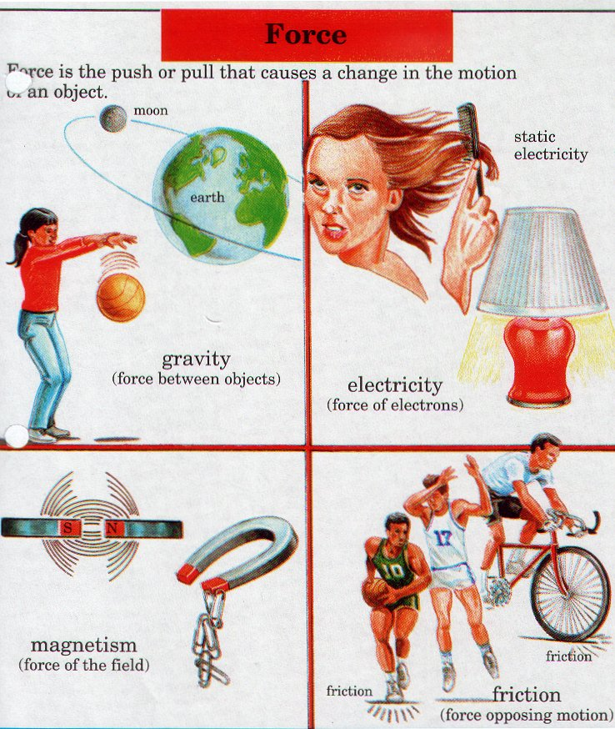
THE CONCEPT OF FORCE

Slide 5
Four Fundamental Forces.
So practically there are just four fundamental forces in the Universe.
Two of them are very familiar to us which we experience in our every day life,
The electromagnetic force, and
The gravitational force.
The other two are invisible unless we probe deep inside the nucleus of the atom. They are called “
Strong nuclear force and the “
Weak nuclear force.

Slide 6
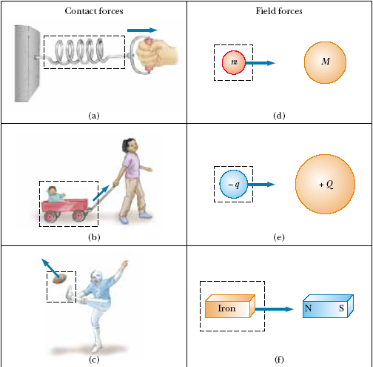
Classes of forces
Contact forces :
Field Force / Action at a distance force

Slide 7

Friction
A force that opposes, or works against, motion of two objects that are touching.

Slide 8
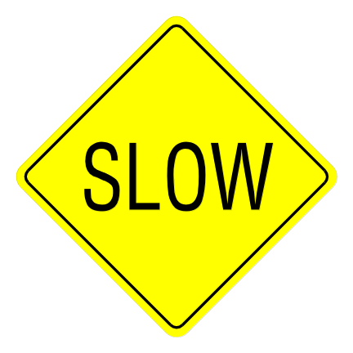

Friction
Friction causes an object to slow down and stop.
Since the amount of energy stays constant, the energy becomes heat.
Notes:
Air resistance is an another example of friction.
Lubricants or grease reduce friction.

Slide 9
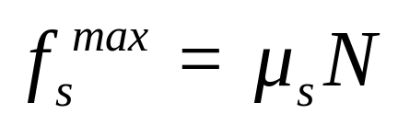
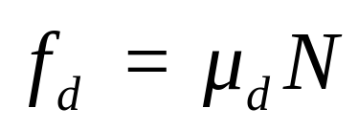
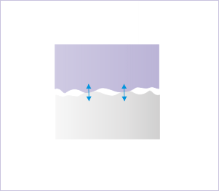
Frictional Forces
Friction: a contact force parallel to the contact surfaces.
Static friction acts to prevent objects from sliding.
Kinetic friction acts to make sliding objects slow down. Sometimes called Dynamic friction.

Slide 10
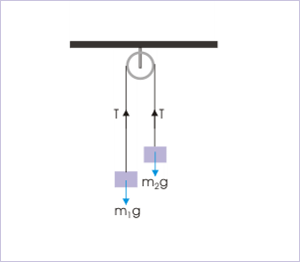
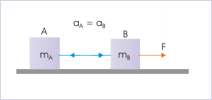
Tension
This is the force transmitted through a “rope” from one end to the other.
An ideal cord has zero mass, does not stretch, and the tension is the same throughout the cord.

Slide 11
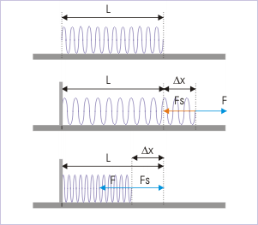
 | Spring Force
The spring force is the force exerted by a compressed or stretched spring upon any object that is attached to it. An object that compresses or stretches a spring is always acted upon by a force that restores the object to its rest or equilibrium position.

Slide 12
Normal Forces
Normal force: this force acts in the direction perpendicular to the contact surface.
N
Normal force of the ground on the box
N
Normal force of the ramp on the box
w
w

Slide 13
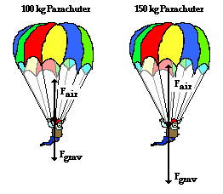
Air Resistance Force
The air resistance is a special type of frictional force that acts upon objects as they travel through the air. The force of air resistance is often observed to oppose the motion of an object. This force will frequently be neglected due to its negligible magnitude (and due to the fact that it is mathematically difficult to predict its value). It is most noticeable for objects that travel at high speeds (e.g., a skydiver or a downhill skier) or for objects with large surface areas.

Slide 14
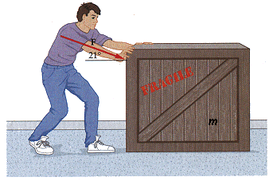
Applied Force
An applied force is a force that is applied to an object by a person or another object. If a person is pushing a desk across the room, then there is an applied force acting upon the object. The applied force is the force exerted on the desk by the person.

Slide 15
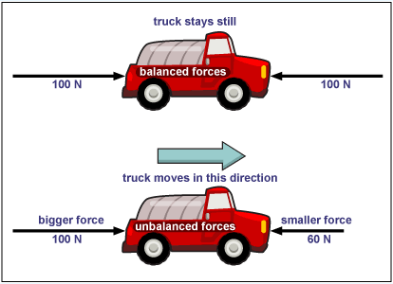
Balanced Force
Equal forces in opposite
directions produce no motion

Slide 16
Unbalanced Forces
Unequal opposing forces
produce an unbalanced force
causing motion

Slide 17
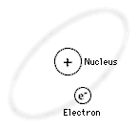
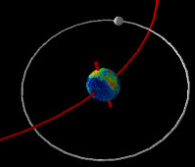
Laws of Motion
If an object moves with uniform motion (constant velocity),no force is required for the motion to be maintained.
Moon-Earth system , Electron revolves around nucleus

Slide 18
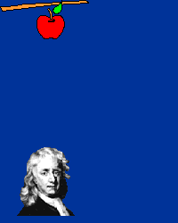
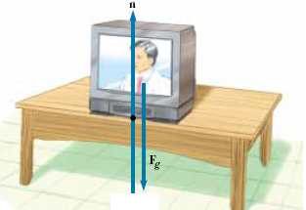
Laws of Motion
What happens when several forces act simultaneously on an object?
The object accelerates only if the net force(total/resultant/unbalance), acting
on it is not equal to zero.
If the net force exerted on an object is
zero, then the acceleration of the object is
zero and its velocity remains constant.
The object is said to be in equilibrium.

Slide 19

Newton’s First Law
An object at rest will stay at rest, and an object in motion will stay in motion at constant velocity, unless acted upon by an unbalanced force.
Once airborne, unless acted on by an unbalanced force (gravity and air – fluid friction), it would never stop!
Unless acted upon by an unbalanced force, this golf ball would sit on the tee forever.

Slide 20
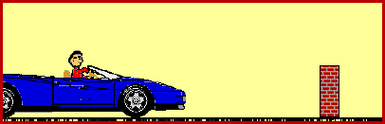
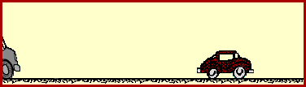
Inertia
The tendency of an object to resist any attempt to change its velocity is called the inertia of the object.
Don’t let this be you. Wear seat belts.
Because of inertia, objects (including you) resist changes in their motion. When the car going 80 km/hour is stopped by the brick wall, your body keeps moving at 80 m/hour.

Slide 21

Mass:
Mass is that property of an object that specifies how much inertia the object has.
The greater the mass of an object, the less that object accelerates under the
action of an applied force.
Mass is an inherent property of an object and is independent of the object’s surroundings and of the method used to measure it. Mass is a scalar quantity.
Weight :
The weight of an object is equal to the magnitude of the gravitational force exerted on the object and varies with location.
F =mg
For example, a person who weighs 180 lb on the Earth weighs only about 30 lb on the Moon. On the other hand, the mass of a body is the same everywhere: an object having a mass of 2 kg on the Earth also has a mass of 2 kg on the Moon. Weight is a vector quantity .

Slide 22
What causes “weightlessness”?
Even in the space shuttle, there is a force of attraction exerted by the earth on the shuttle and its contents.
When the space shuttle temporarily “falls” toward the earth, the contents of the space shuttle appear to be weightless, but in fact they are falling with the space shuttle. This is called “freefall”.

Slide 23

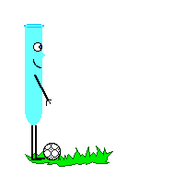

Newton’s Second Law
The acceleration of an object is directly proportional to the net force acting on it and inversely proportional to its mass.
When mass is in kilograms and acceleration is in m/s/s, the unit of force is in Newtons (N).
One Newton is equal to the force required to accelerate one kilogram of mass at one meter/second/second

Slide 24
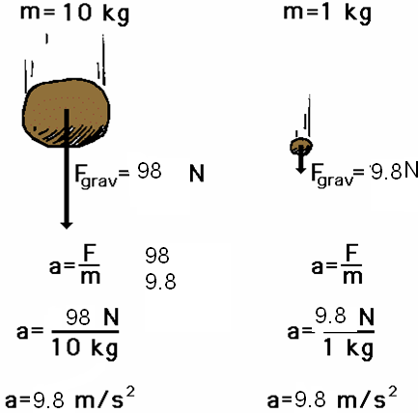
Newton’s 2nd Law proves that different masses accelerate to the earth at the same rate, but with different forces.
We know that objects with different masses accelerate to the ground at the same rate.
However, because of the 2nd Law we know that they don’t hit the ground with the same force.
F = ma
98 N = 10 kg x 9.8 m/s/s
F = ma
9.8 N = 1 kg x 9.8 m/s/s

Slide 25


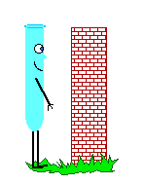
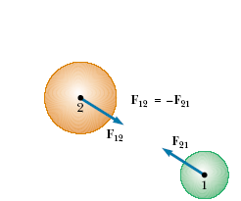
Newton’s Third Law
For every action, there is an equal and opposite reaction.

Slide 26

Newton’s 3rd Law in Nature
Consider the propulsion of a fish through the water. A fish uses its fins to push water backwards. In turn, the water reacts by pushing the fish forwards, propelling the fish through the water.
The size of the force on the water equals the size of the force on the fish; the direction of the force on the water (backwards) is opposite the direction of the force on the fish (forwards).

Slide 27

3rd Law
Flying gracefully through the air, birds depend on Newton’s third law of motion. As the birds push down on the air with their wings, the air pushes their wings up and gives them lift.

Slide 28

Consider the flying motion of birds. A bird flies by use of its wings. The wings of a bird push air downwards. In turn, the air reacts by pushing the bird upwards.
The size of the force on the air equals the size of the force on the bird; the direction of the force on the air (downwards) is opposite the direction of the force on the bird (upwards).
Action-reaction force pairs make it possible for birds to fly.

Slide 29
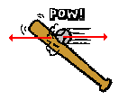

Other examples of Newton’s Third Law
The baseball forces the bat to the left (an action); the bat forces the ball to the right (the reaction).

Slide 30

3rd Law
The reaction of a rocket is an application of the third law of motion. Various fuels are burned in the engine, producing hot gases.
The hot gases push against the inside tube of the rocket and escape out the bottom of the tube. As the gases move downward, the rocket moves in the opposite direction.

Slide 31
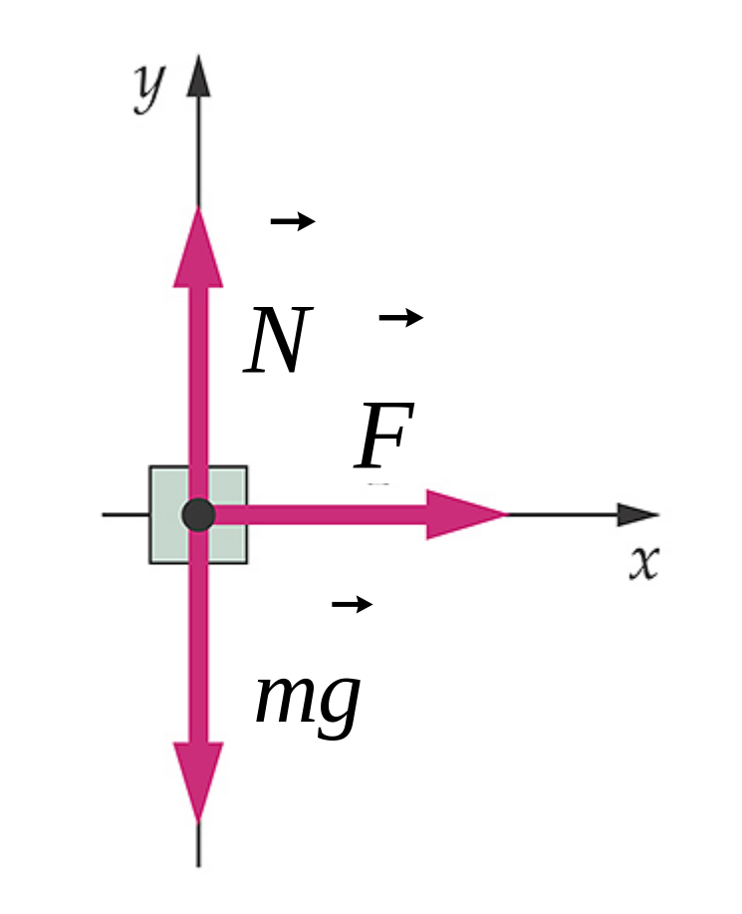
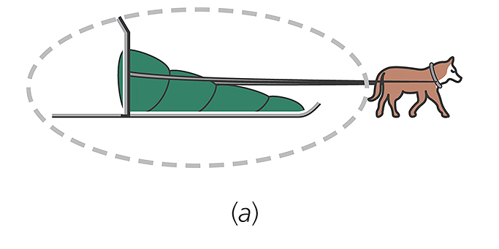
Free Body Diagram

Slide 32
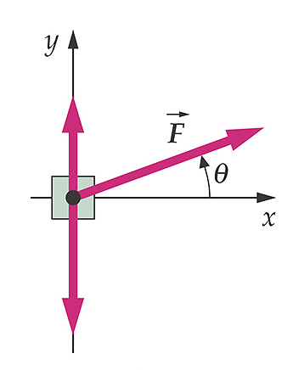
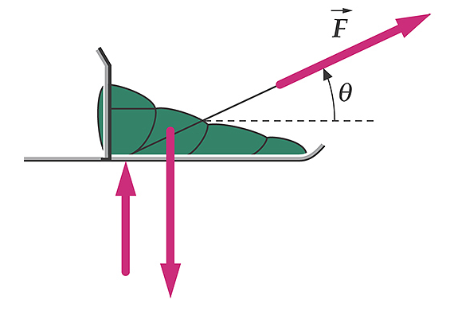
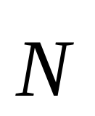
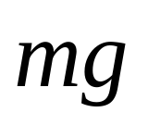
Same problem but the applied force is angled up

Slide 33
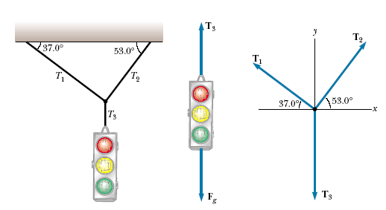



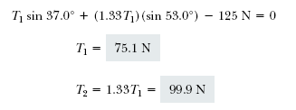

APPLICATIONS OF NEWTON’S LAWS
A Traffic Light at Rest

Slide 34
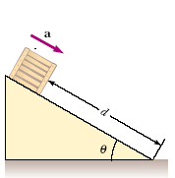


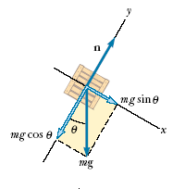

Crate on a Frictionless Incline

Slide 35
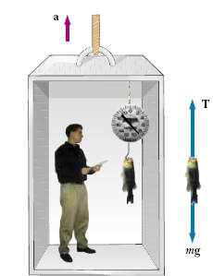
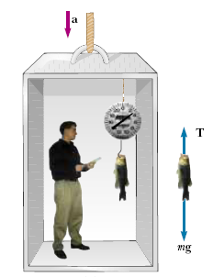

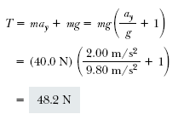

Weighing a Fish in an Elevator
A person weighs a fish of mass m on a spring scale attached to
the ceiling of an elevator, as illustrated in Figure. Show that if the elevator accelerates either upward or downward, the spring scale gives a reading that is different from the weight of the fish.
If the elevator is either at rest or moving at constant velocity, the fish is not accelerating, and so or (remember that the scalar mg
is the weight of the fish).T = mg
If the elevator moves upward with an acceleration a relative to an observer standing outside the elevator in an inertial frame.
The scale reading T is greater than the weight mg if a is upward, so that ay is positive, and that the reading is less than mg if a is downward, so that ay is negative.

Slide 36
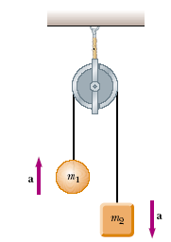

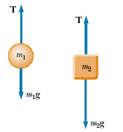



Atwood’s Machine
When two objects of unequal mass are hung vertically over a
frictionless pulley of negligible mass, Determine the magnitude of the acceleration of the two objects and the tension in the lightweight
cord.

Slide 37

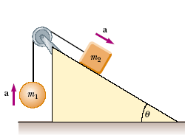



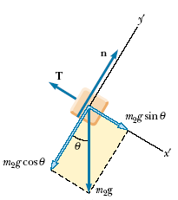

Acceleration of Two Objects Connected by a Cord
A ball of mass m1 and a block of mass m2 are attached by a lightweight cord that passes over a frictionless pulley of negligible mass, as shown in Figure. The block lies on a frictionless incline of angle . Find the magnitude of the acceleration of the two objects and the tension in the cord.

Slide 38
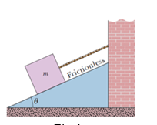
In Fig let the mass of the block be 8.5 kg and the angle be 30 .Find (a) the tension in the cord and (b) the normal force acting on the block. (c) If the cord is cut, find the magnitude of the resulting acceleration of the block.

